Slide 1

Chandra.Lakshmipriya
Exploratory Data Analysis-Beginner
DataScience & Business Analyst Intern

Slide 2
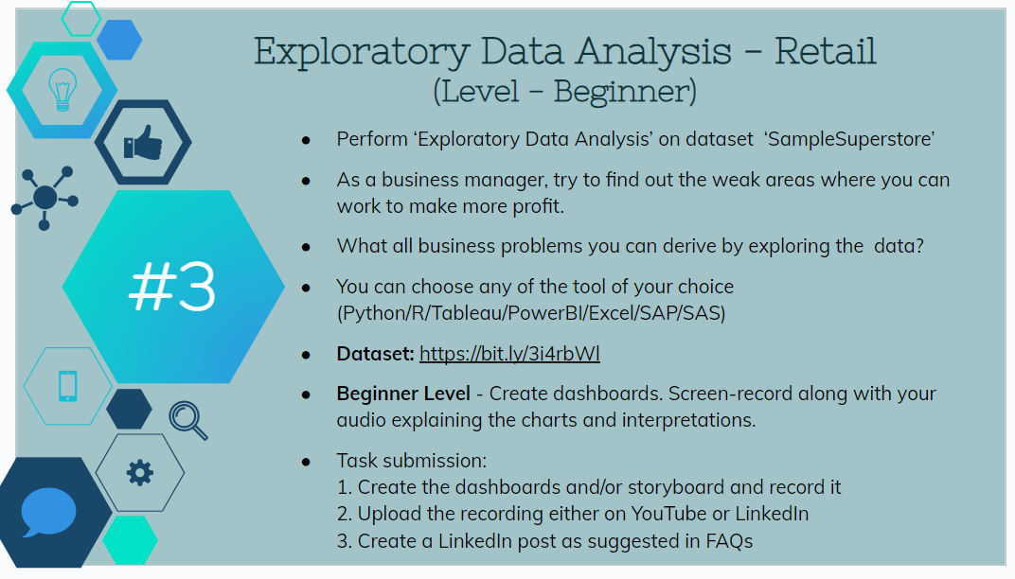
Task-1

Slide 3
What is Retail ?
Retail refers to the sale of goods or services to end consumers for personal use. It involves the process of selling products directly to individual customers, typically in small quantities.
In a retail transaction, the customer pays a price that covers the cost of the product or service, along with any associated expenses and the retailer's profit margin.
The retail industry is diverse and dynamic, adapting to changes in consumer preferences, technology, and market trends.

Slide 4
Exploratory Data Analysis….!
Exploratory Data Analysis (EDA) is an approach to analyzing and visualizing data sets to summarize their main characteristics, often with the help of statistical graphics and other data visualization methods.
The primary goal of EDA is to understand the patterns, relationships, and trends in the data and to generate hypotheses that can guide further investigation.
Exploratory Data Analysis is a crucial step in the data analysis process as it helps analysts and data scientists gain insights, formulate hypotheses, and make informed decisions about subsequent analyses.

Slide 5
Factors of Business Problems..!
Internal Factor
External Factor
Pricing
Innovation
Material
New Trend
Competitor
Digital Expansion

Slide 6
Data Exploring…!
Data is in CSV format
Rows-9995
Columns-13

Slide 7
Data Visualization….!
Data Visualization has done using Microsoft Power Bi .
Cards, Pie Chart, Slicers, Line Chart, Clustered Column Chart and Stacked Column Chart these are the visualizations I used in data visualization .

Slide 8
Results:
Profit by Category :
Furniture-18.45k/742.00k sales
Office Supplies-122.49k/719.05k sales
Technology- 145.45k/836.15k sales
Profit by Region:
West Region(highest)-108k
Central Region(lowest)-40k

Slide 9
Results:
Sales and Profit by Segment :
Consumers-134k P /1.16 M sales(50.56%)
Home Office-60k P/0.43 M sales(18.7%)
Profit by Ship Mode:
Standard Class(highest)-164k
Same Day (lowest)-16k

Slide 10
Improvements in Data Collection…!
Pricing Details
Shipping Area
Customers feedback
Returns and Cancellation Details ( if any)

Slide 11
Suggestions….!!
Ask customers to Give Feedback
Technology Implementation
Maintain Communication with customers according to their way of purchasing.
Inventory Management
Recruit Some educated and active Staff
Offers and discounts & Uniqueness
Convenience.

Slide 12
Thank You

